Slide 1
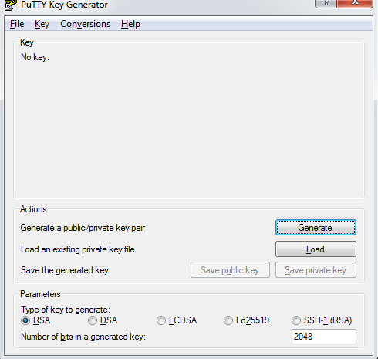
Download software putty and Puttygen
Open puttygen and click on Load where you can select Key pair(PEM file) and
click on “save Private Key”. It will automatically generate PPK file.Save this file.

Slide 2
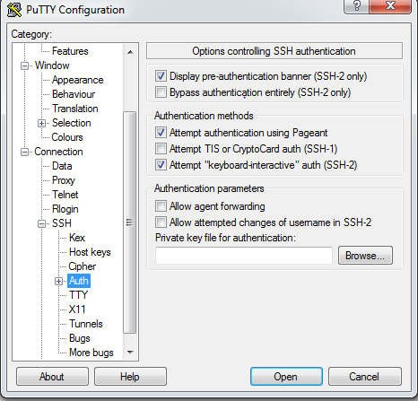
3. Open Putty and go to SSH -> Auth and click Browse option and select PPK file which you saved in previous step and click Open.
4. Click on Session and give ip address 13.58.30.117. Click on Open

Slide 3
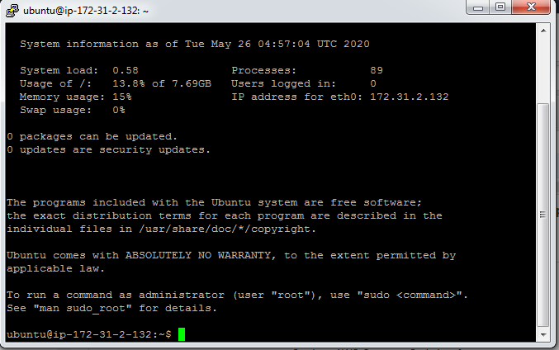
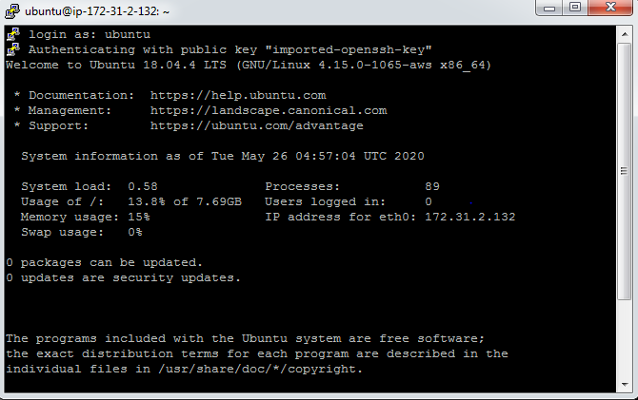
5. Log in as Ubuntu and press Yes the terminal will open automatically where you can access the Ubuntu server.

